Slide 1
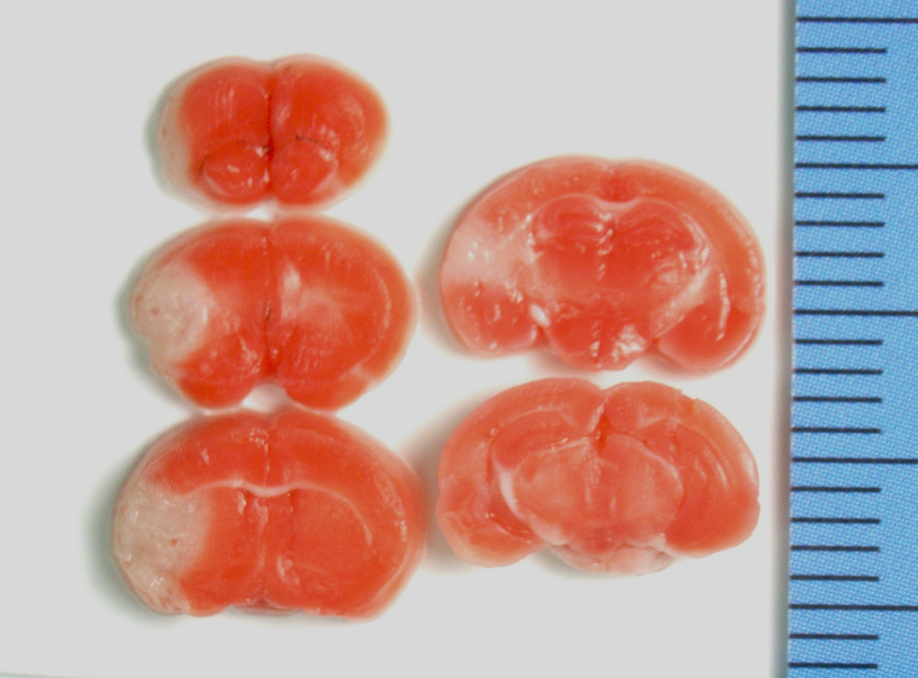
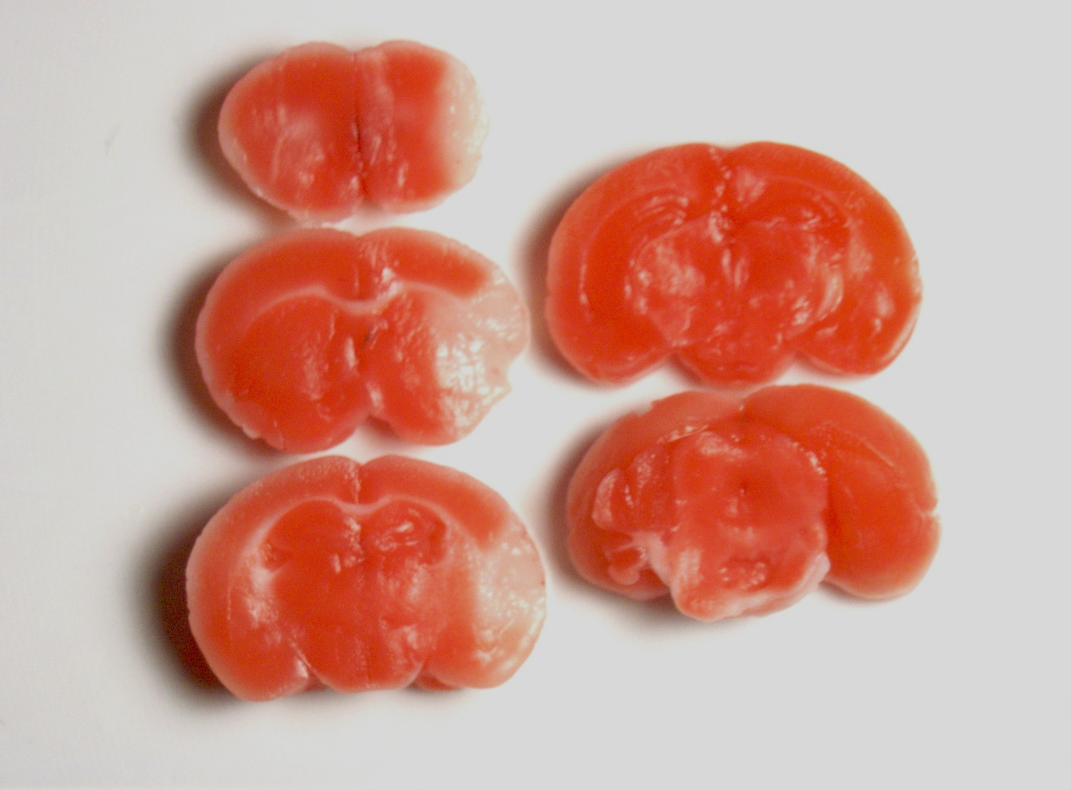
Ms.3325(female, 48 hours after MCAO)
Stroke volume: 31.79mm³

Slide 2
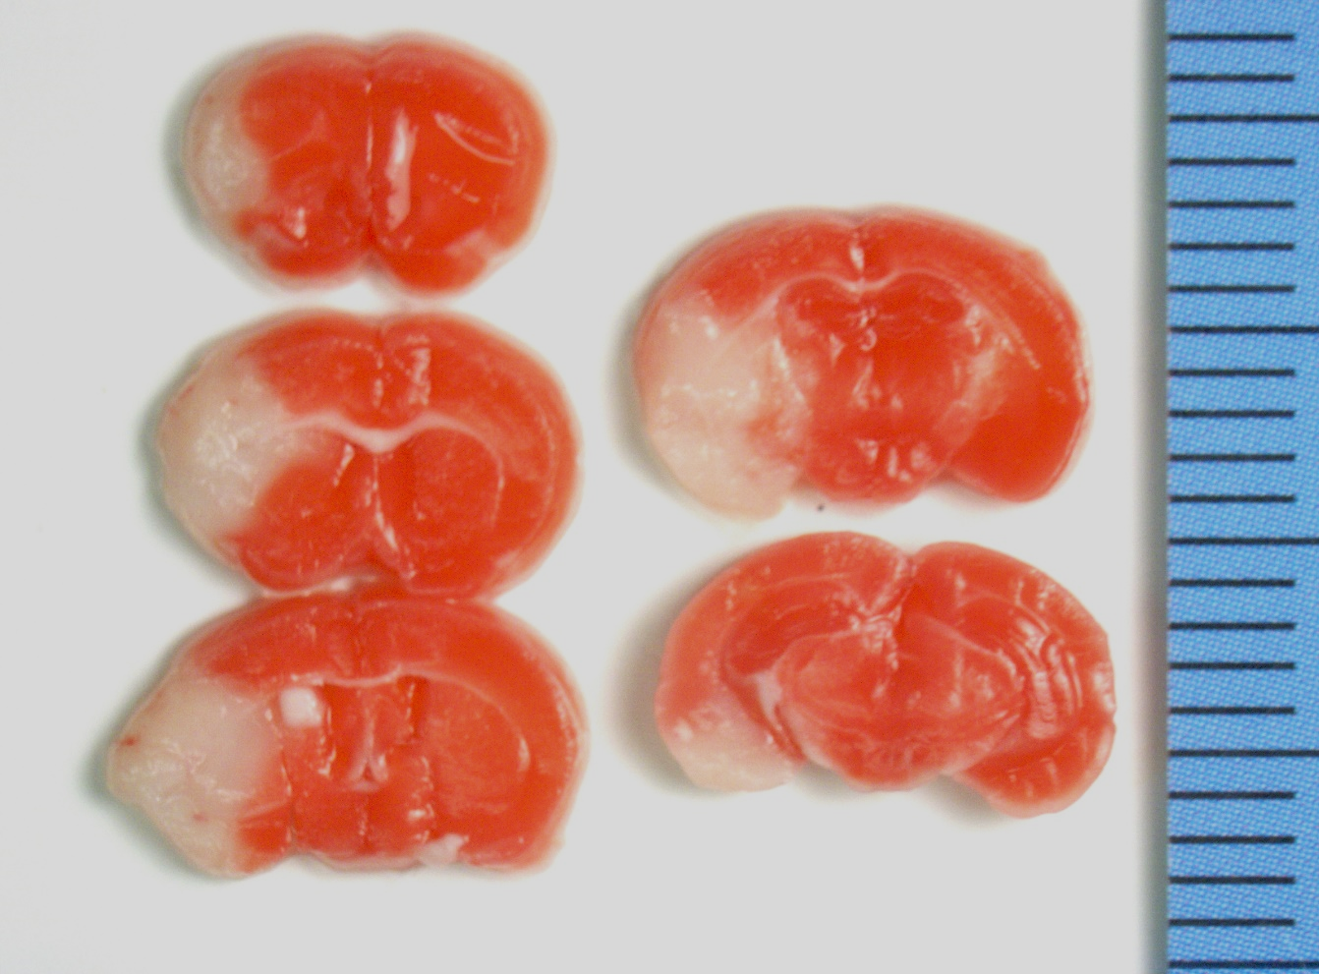
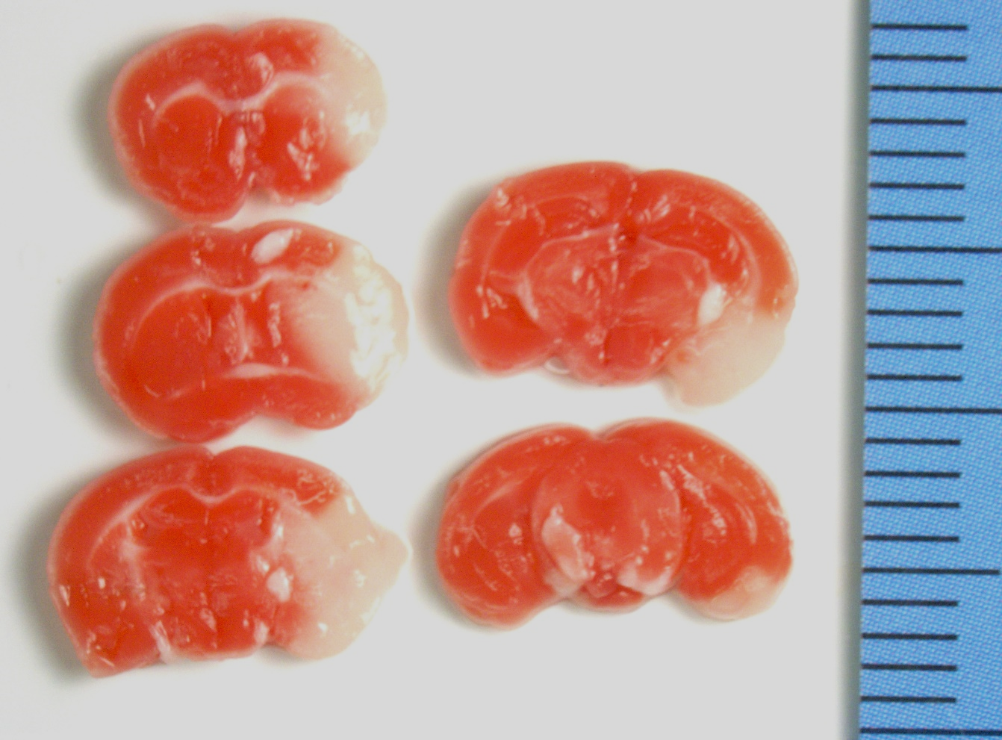
Ms.3326(female, 48+4 hours after MCAO)
Stroke volume: 58.07mm³

